Slide 1
Plan for today (February 14th 2024)
Mosaics with zero-crossing
Discovered that we can get a full mosaic by “fusing” 2 types
2. Fixed an important bug: Parameters were not initialized randomly
3. Experiment with 3 channels being M cones
Failure mode: Not all neurons converge to ON or OFF mosaics

Slide 2
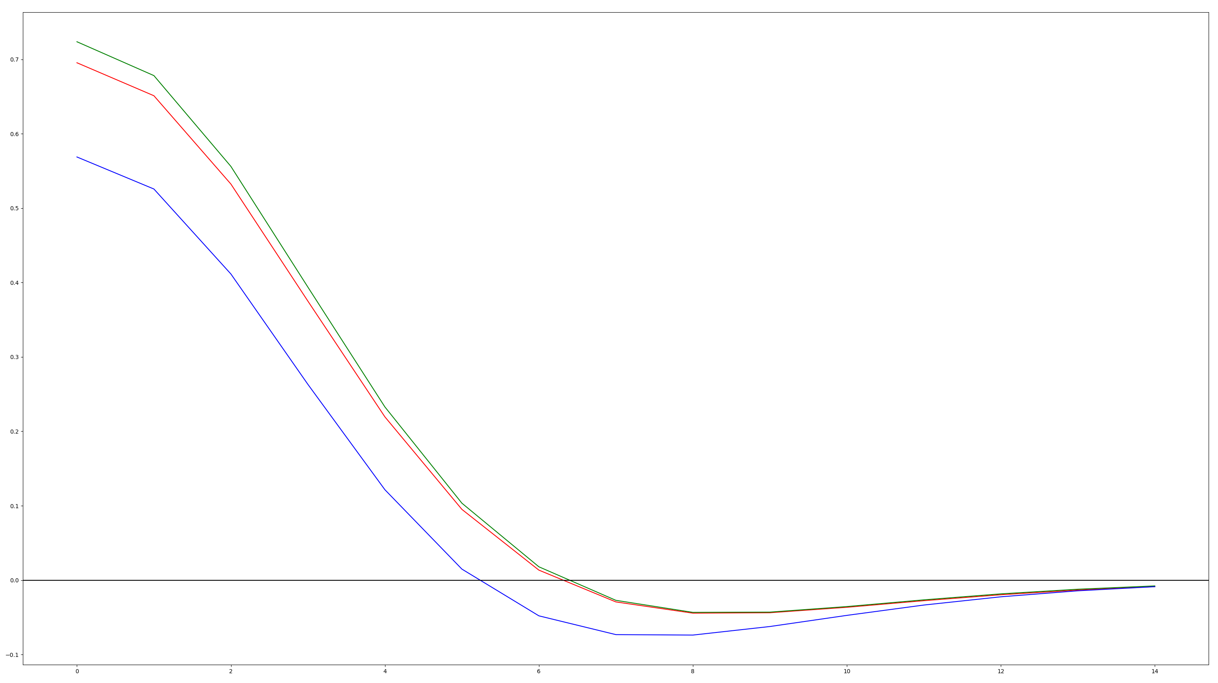
How I determined zero-crossings

Slide 3
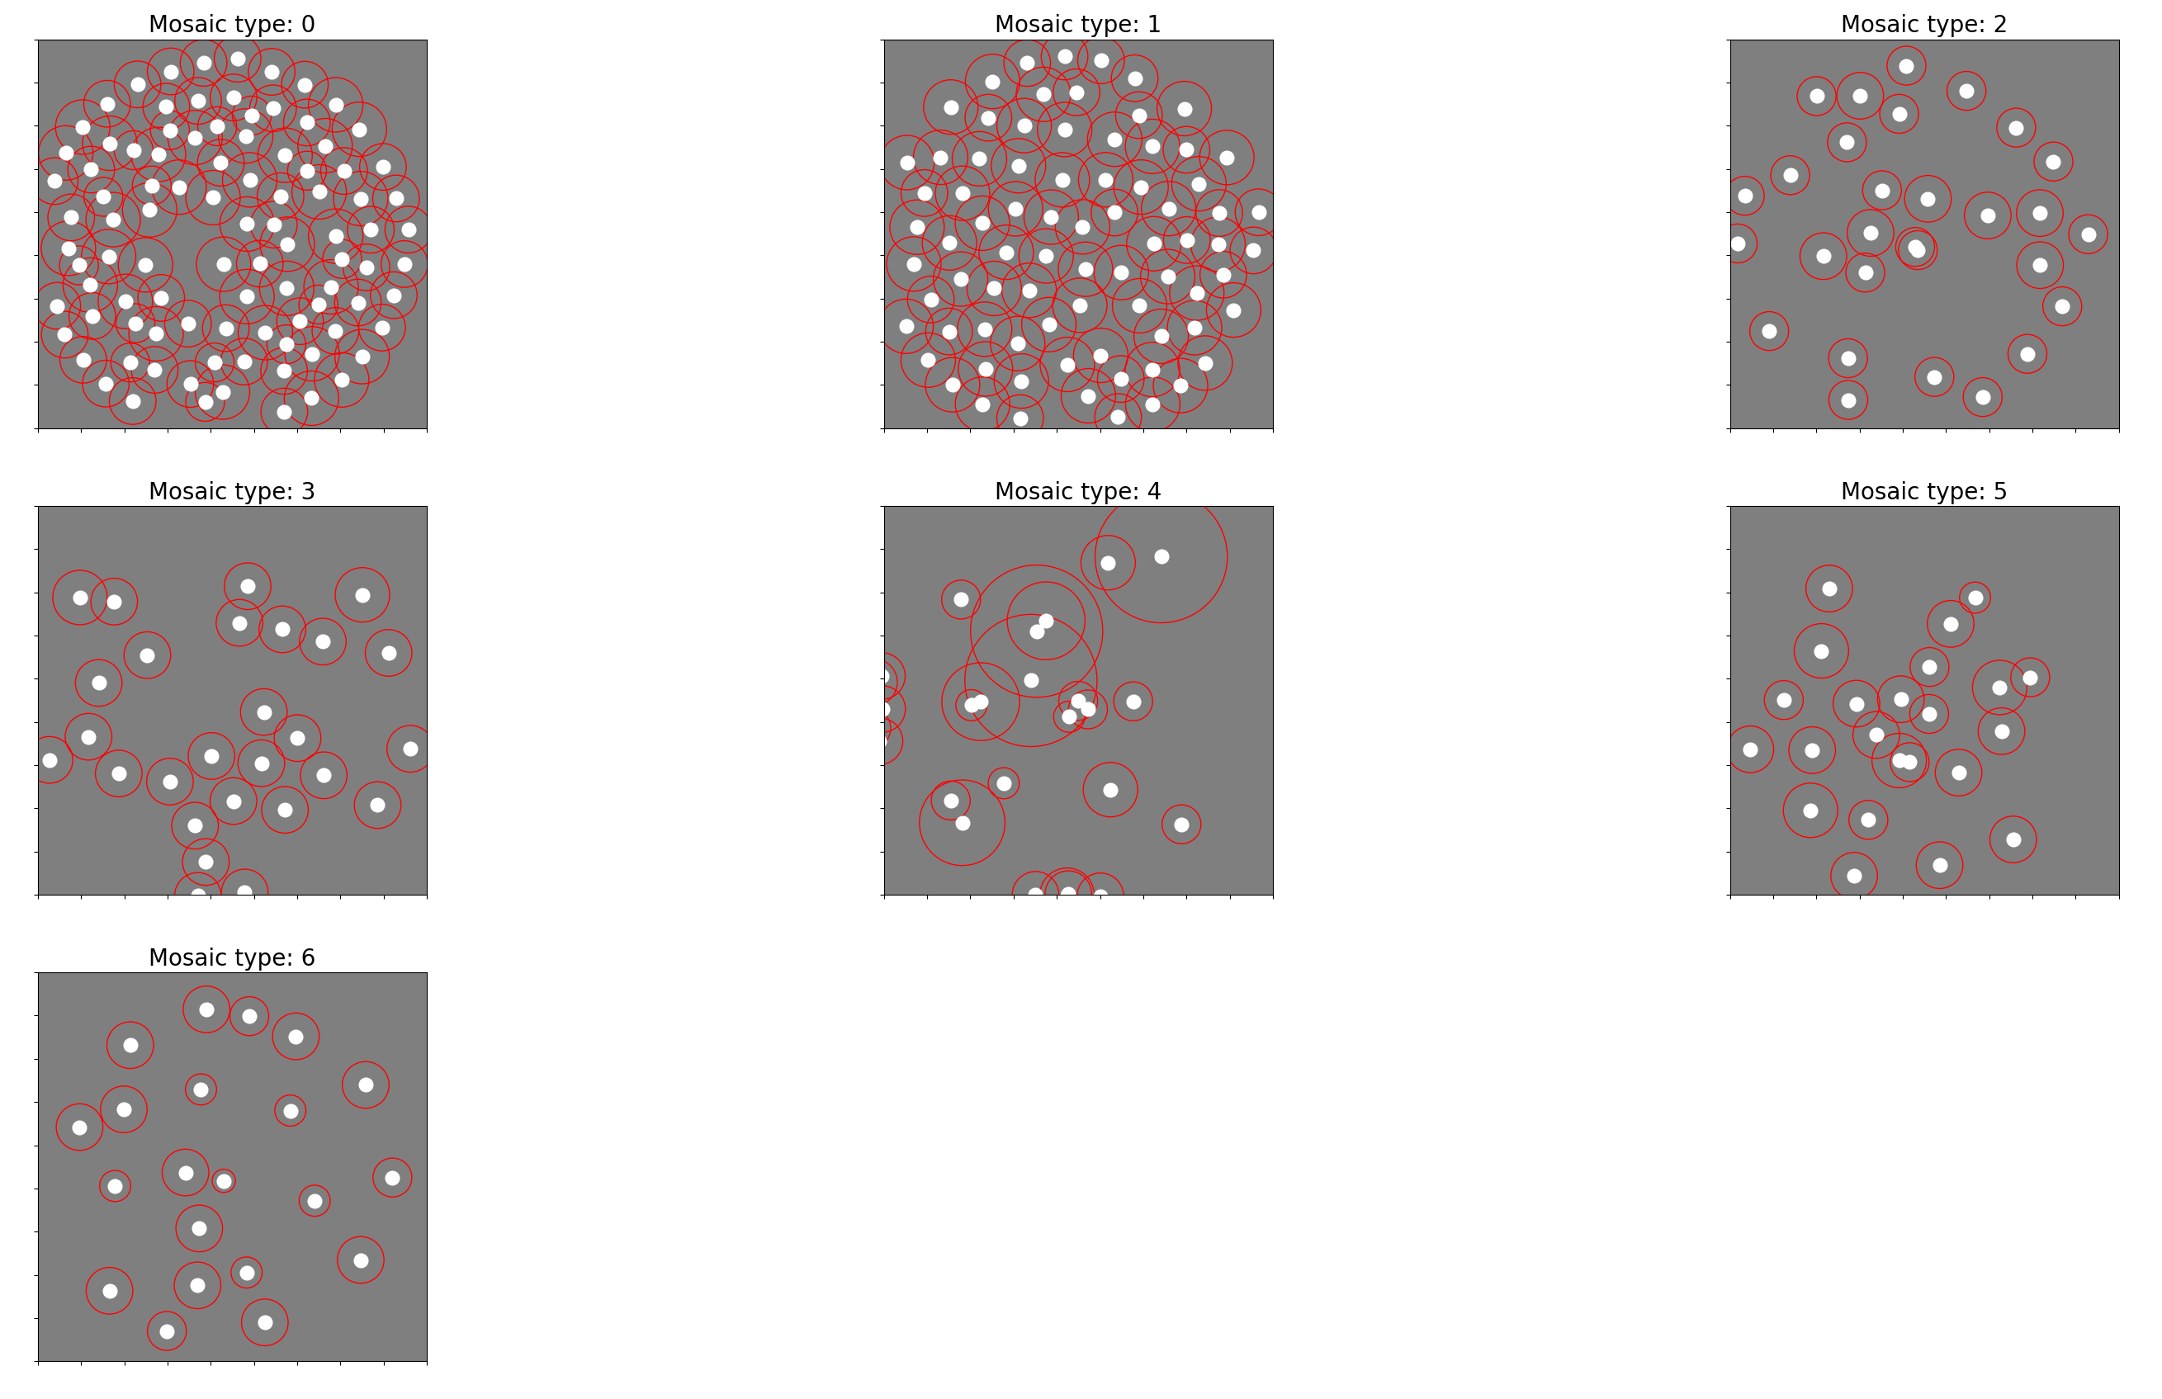
Mosaics 2 and 3 “complement” each other
Mosaic 2: OFF midget
Mosaic 3: OFF midget + OFF S inputs
240125-183448

Slide 4
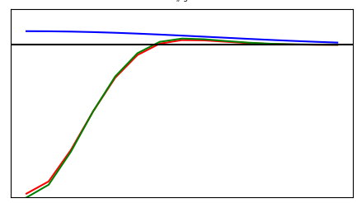
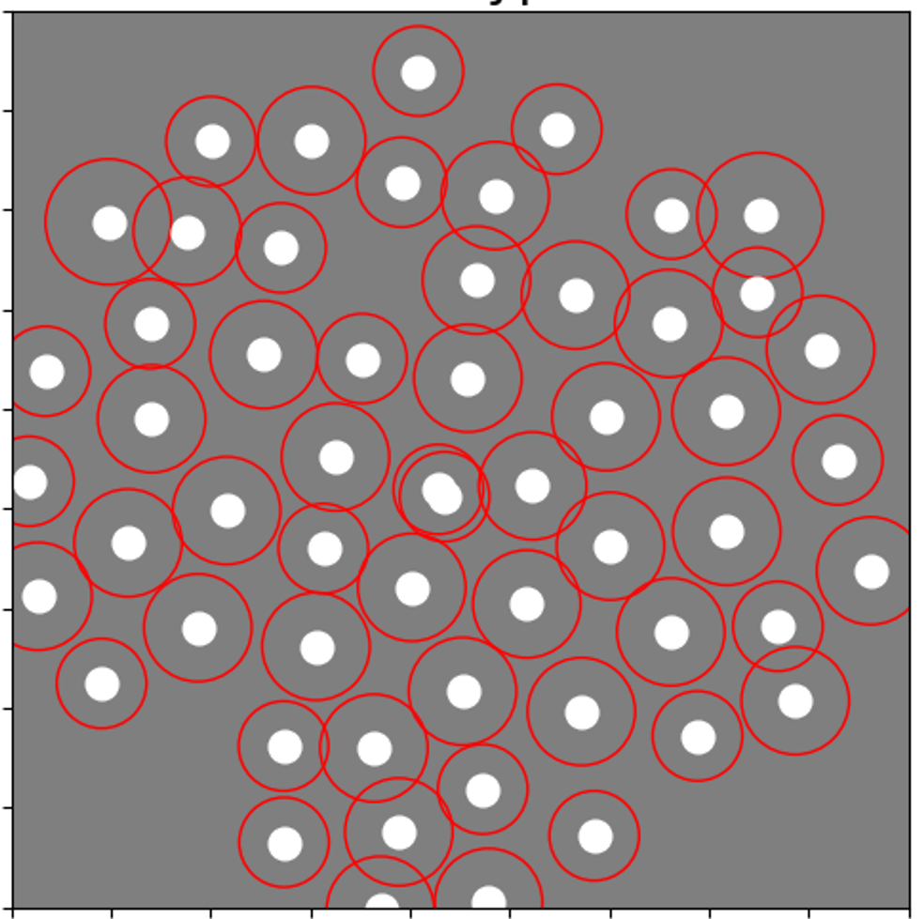
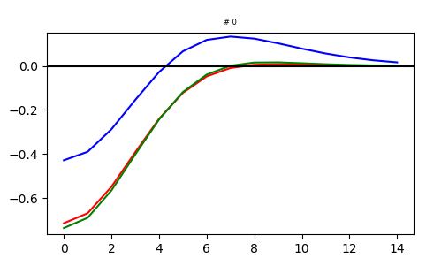
Mosaic 2 + Mosaic 3
Mosaic 2 example:
Mosaic 3 example:

Slide 5
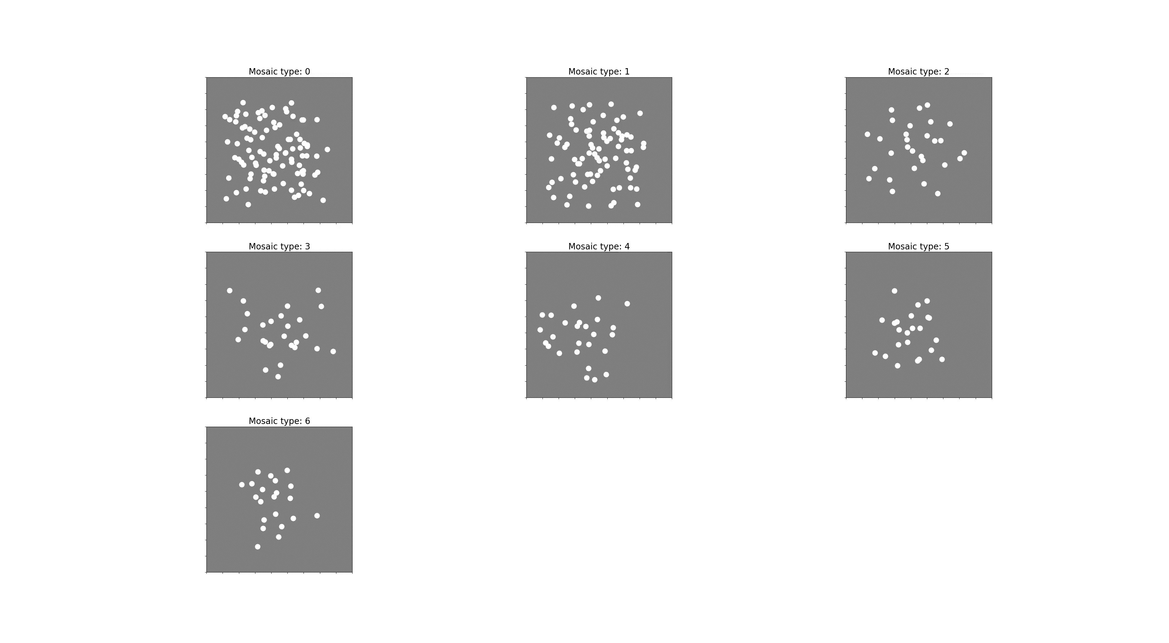
Video: 300 neurons 18x18x3

Slide 6
Fixing bugs
What I thought I was doing:
Sampling the initial parameters for each neuron from a normal distribution with means (-3, -3, 0, 0) and standard deviation of 1.
What I was actually doing:
All parameters but d were initialized to be the same for each neuron.
d was drawn from a normal distribution with mean = 0 and std = 1.
What I’m doing now
Sampling initial parameters from each neuron from a normal distribution with means that correspond to the converged parameter values and std = 1.
Unfortunately, that didn’t fix the mosaics

Slide 7
Experiment
- All 3 colors channels are the same: M inputs.
- kernels are 18x18x3
- DoG parametrization
- 2M epochs
What you would expect: All neurons fall within ON and OFF mosaics
Name for future reference: 240212-143644

Slide 8
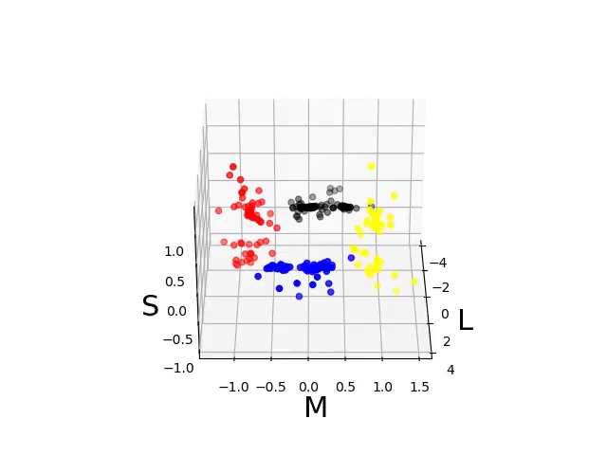
PCA of radial averages

Slide 9
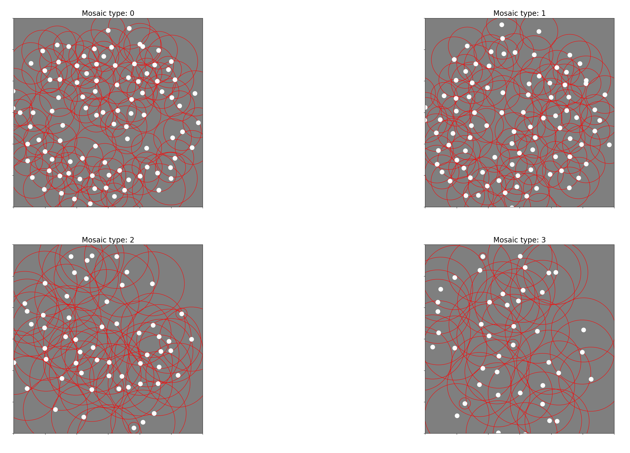
Mosaics of each cluster

Slide 10
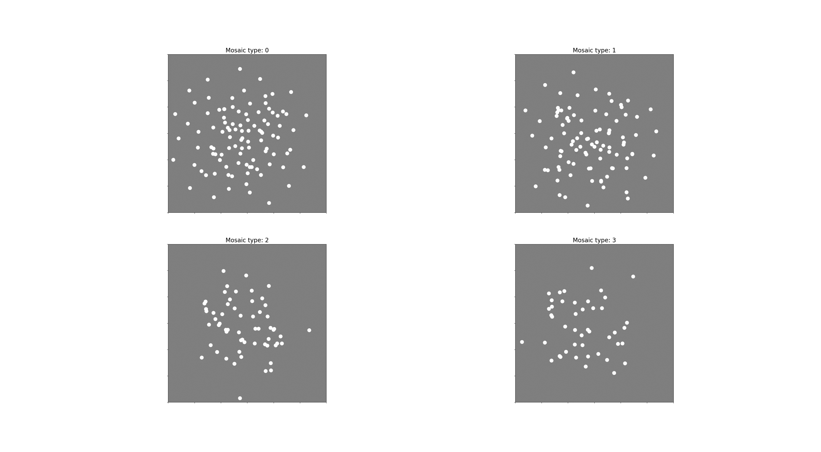
Video version

Slide 11
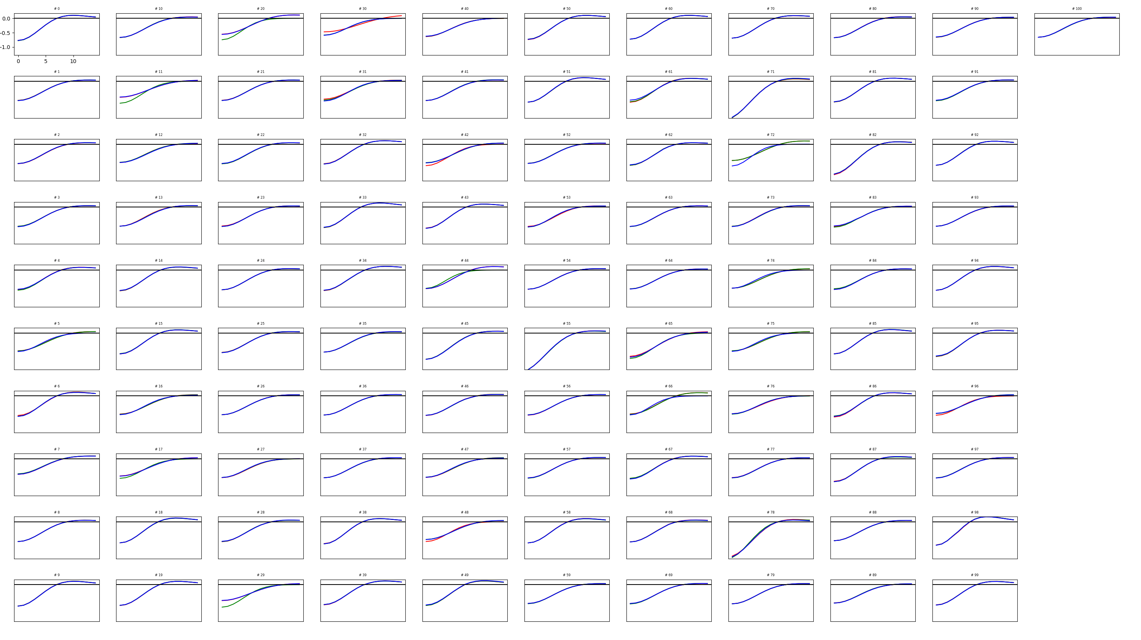
First cluster

Slide 12
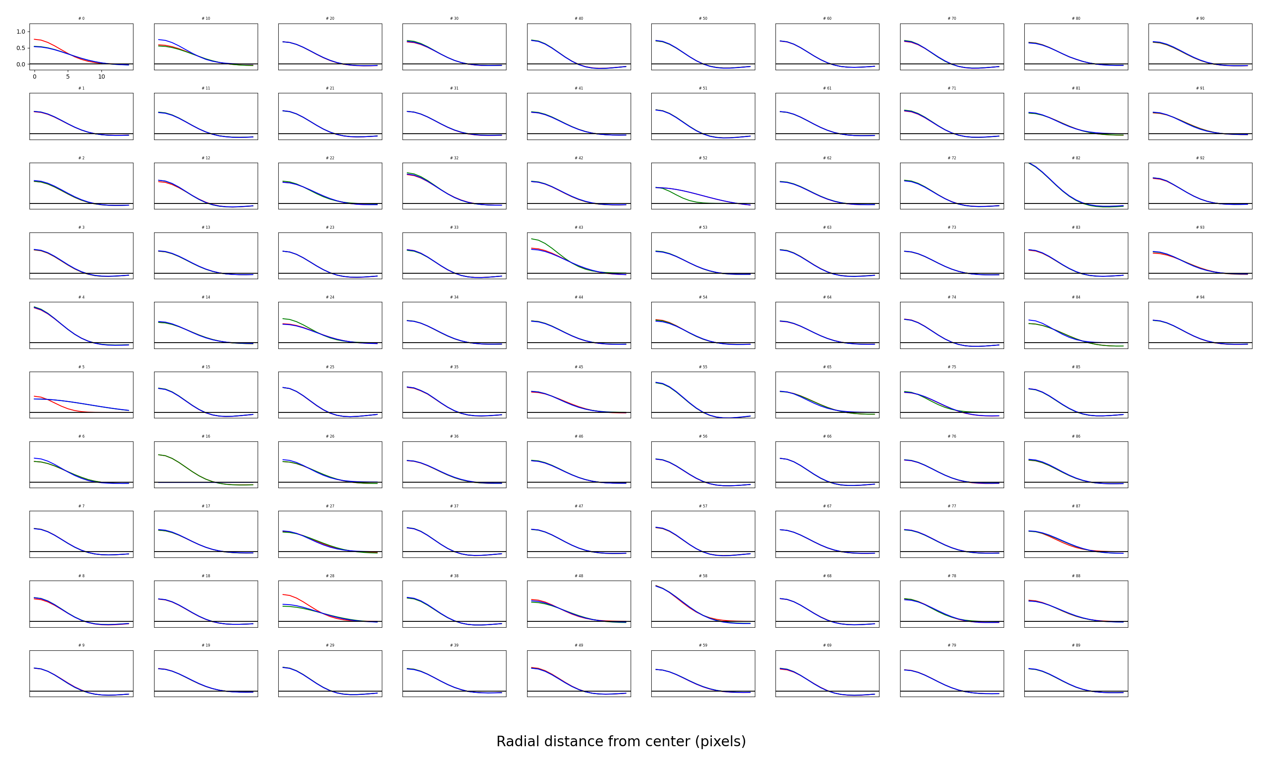
Second cluster

Slide 13
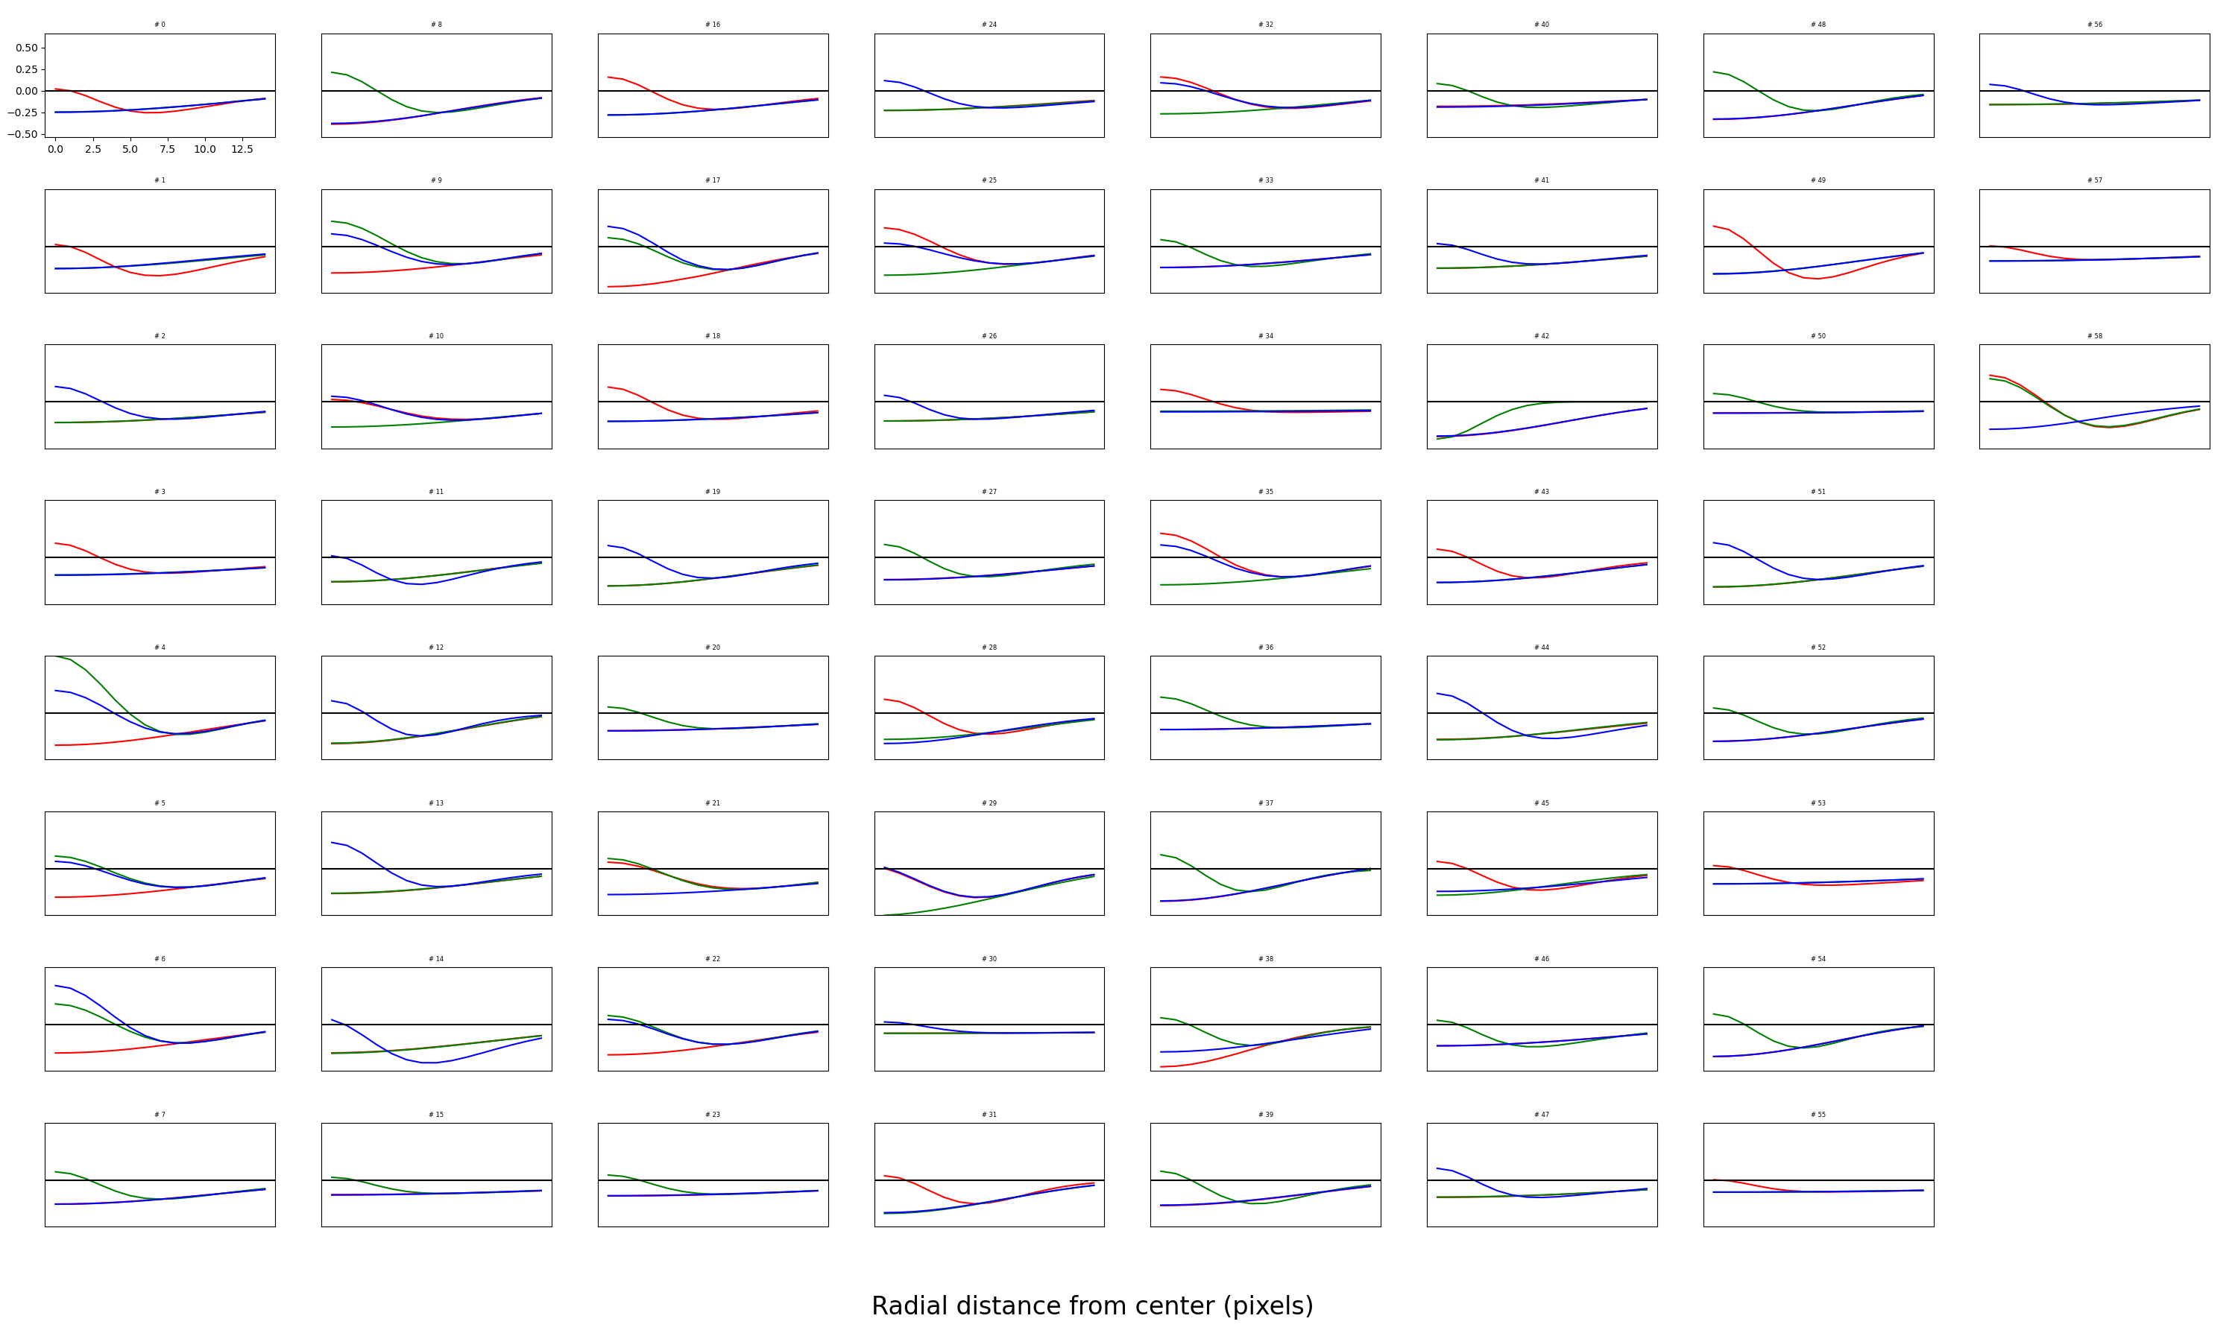
Third cluster

Slide 14
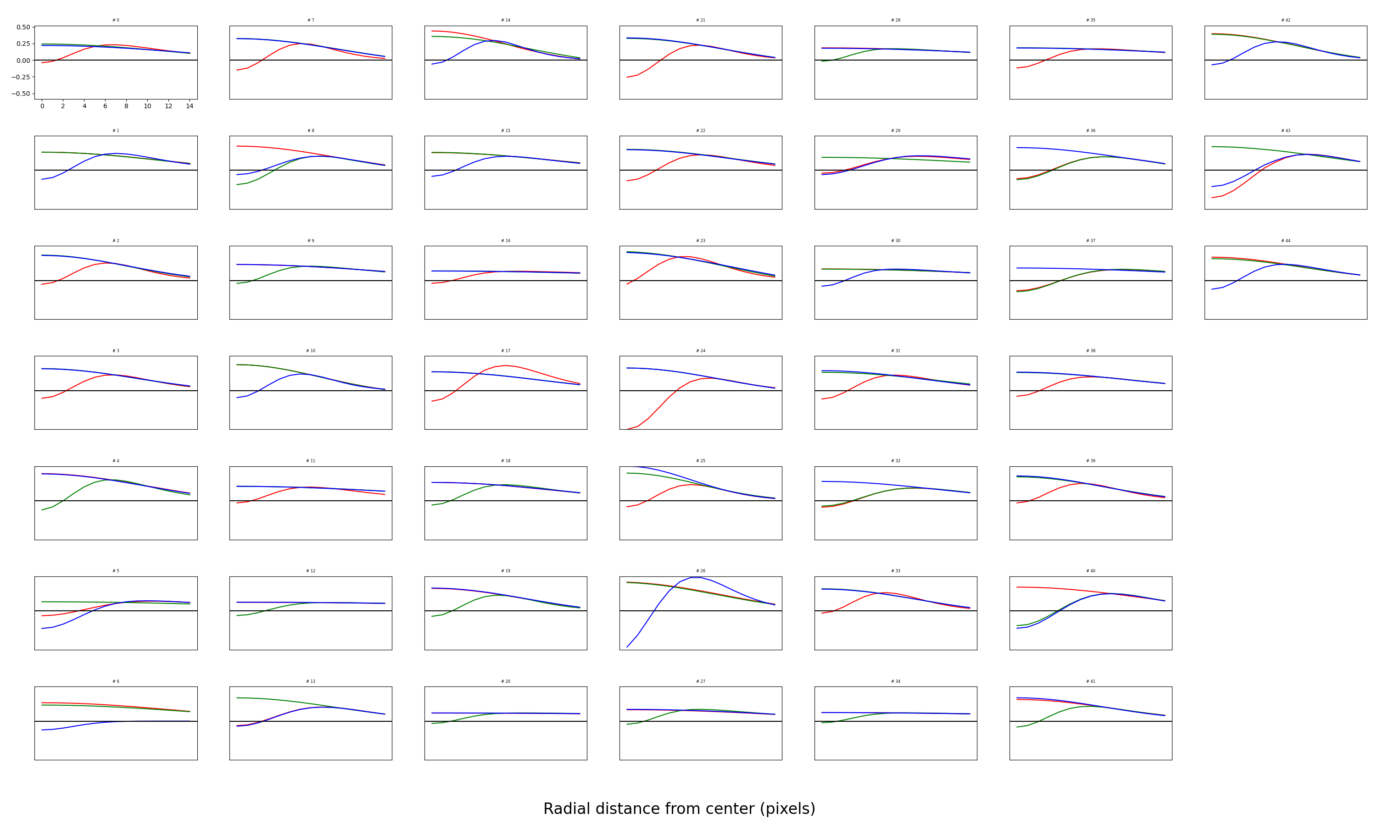
Fourth cluster

Slide 15
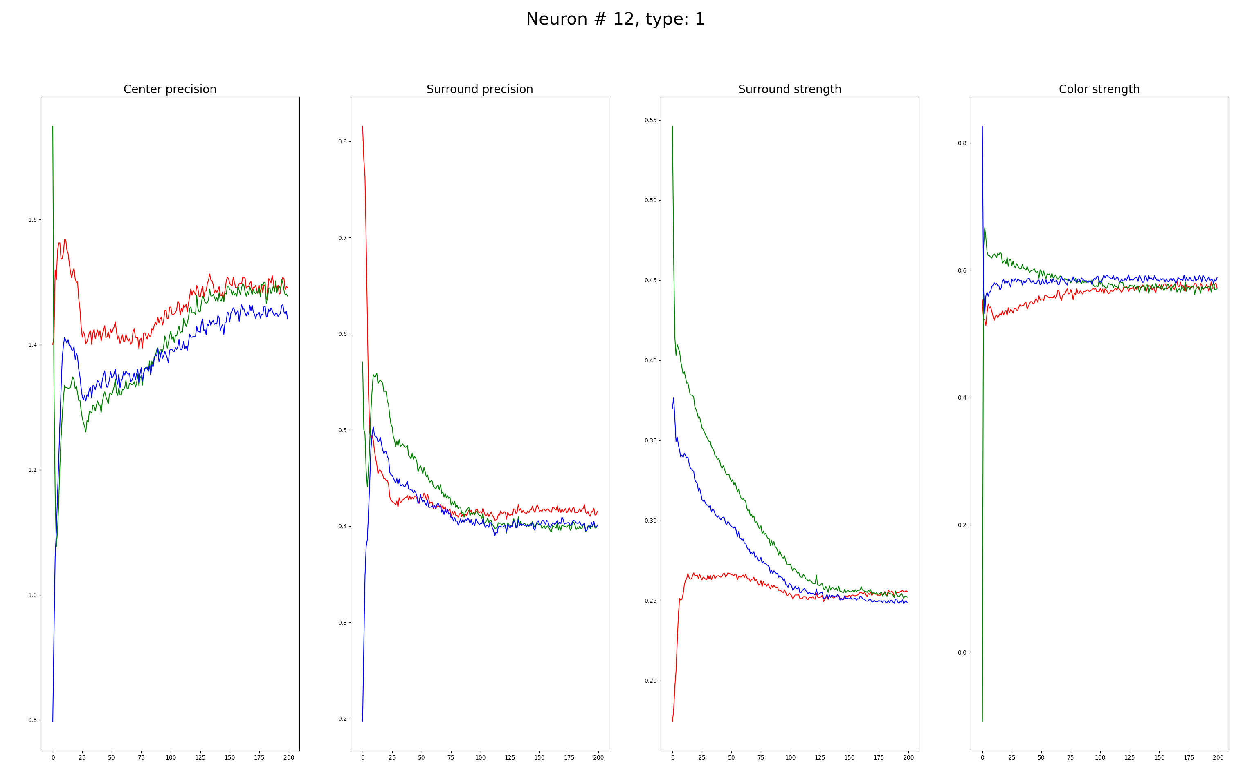
Parameters over time of a “good” neuron

Slide 16
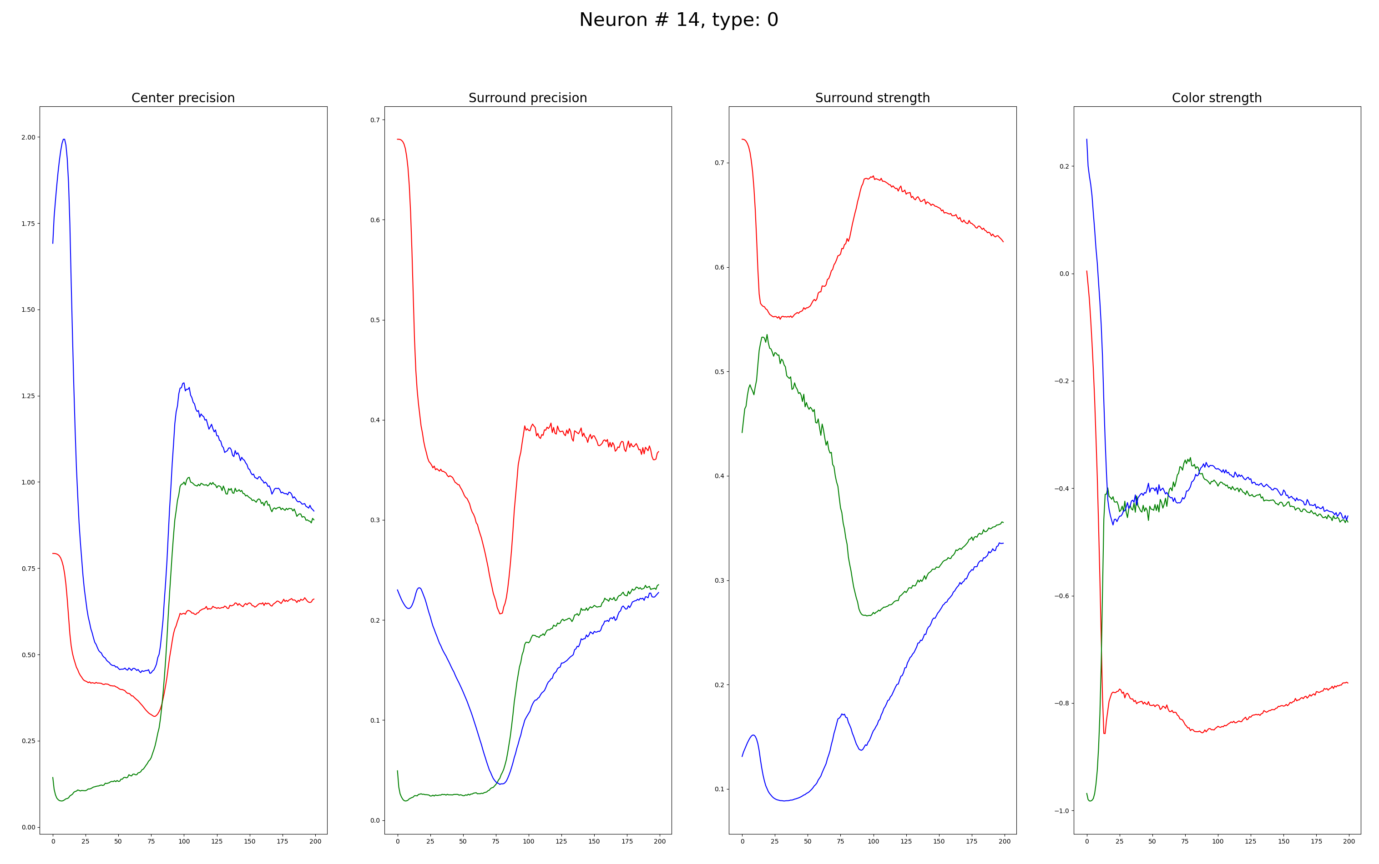
Some neurons haven’t converged but look good

Slide 17
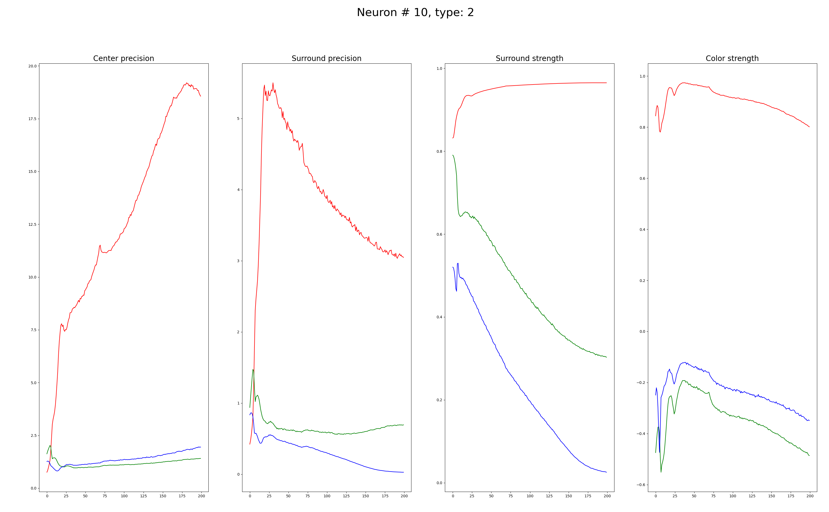
In bad neurons, the center precision goes up indefinitely

Slide 18
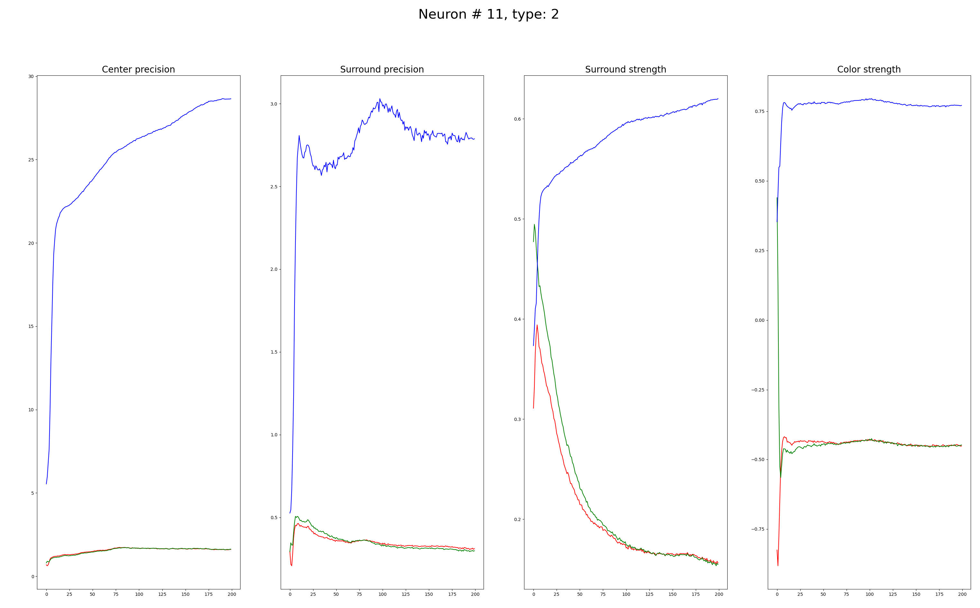

Slide 19
Memory limit
What does influences the limit:
Number of neurons, batch size
What doesn’t influence the limit:
Kernel size, number of channels
Why is that?
It would be possible to run 1000 neurons with a batch size of 16.
For 3M epochs, it would take ~55 hours.

